Slide 1

WILSON SPORTING GOODS
GROUP MEMBERS
WAJAHAT MANSOORI
YASEEN SALEEM
ANAS ANSARI
UBAIKA
FACULTY:
MISS RABIYA AMIN

Slide 2
PROJECT OVERVIEW
Our project is basically about sporting goods
Time saving & just one click to buy products

Slide 3
ADVANTAGES
We divided our online shop into two section such as Men & Women categories
User can also easily buy product according to their choice of the brands.

Slide 4
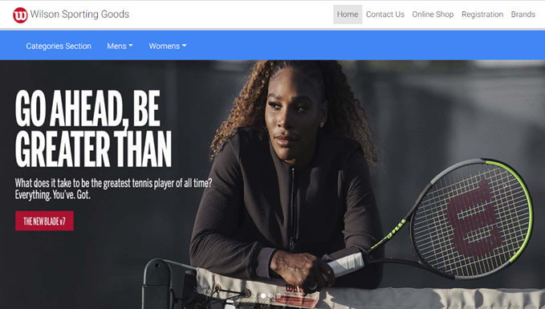
HEADER

Slide 5
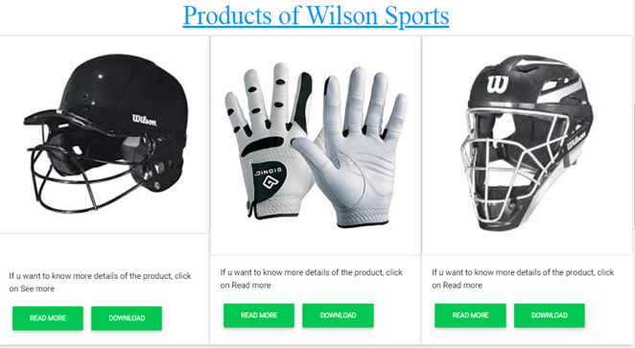
HOME PAGE

Slide 6
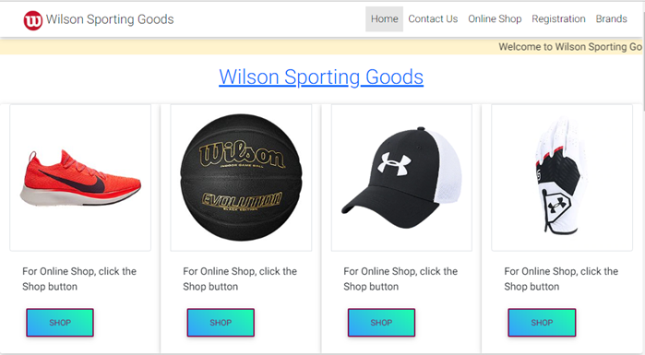
ONLINE SHOP

Slide 7
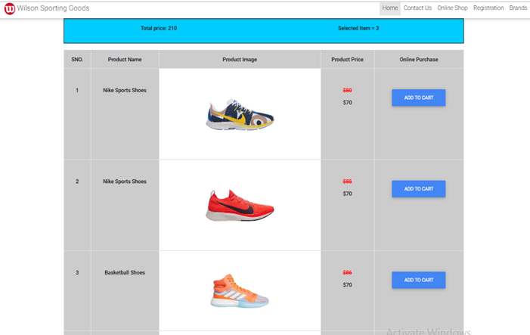
ONLINE SHOP

Slide 8
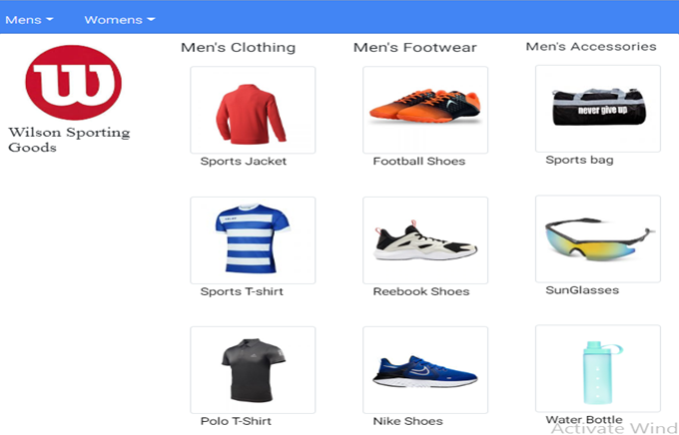
CATEGORIES SECTION

Slide 9
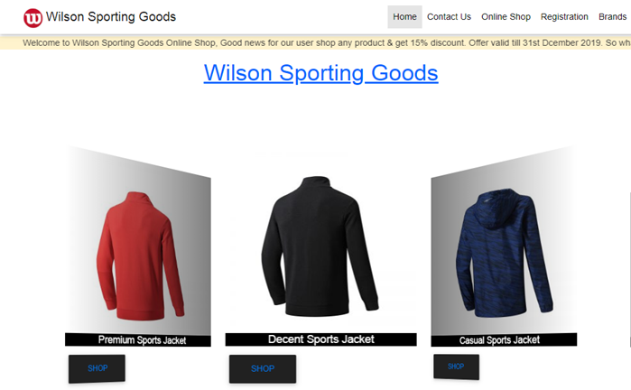
CATEOGORIES SECTION

Slide 10
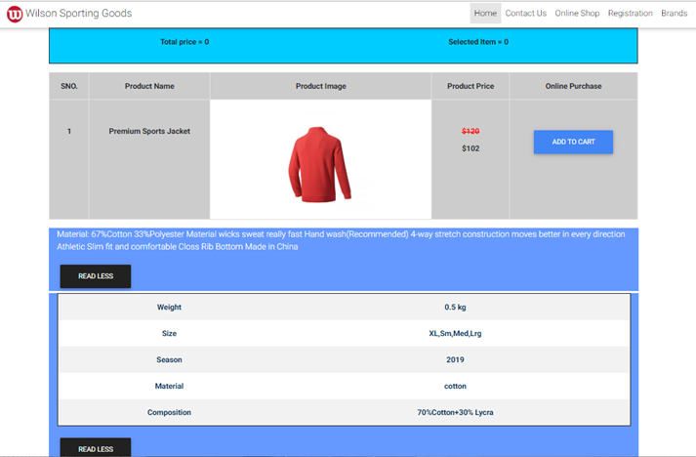
CATEGORIES SECTION

Slide 11
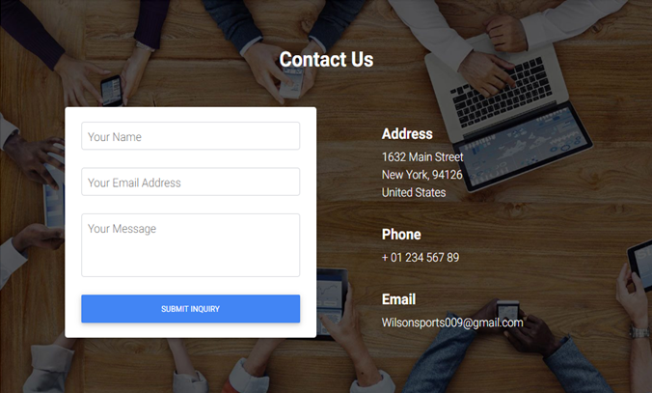
CONTACT US

Slide 12
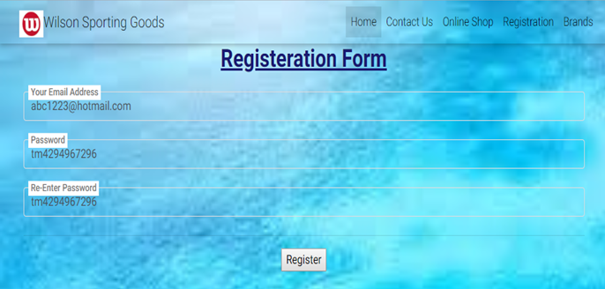
REGISTRATION

Slide 13
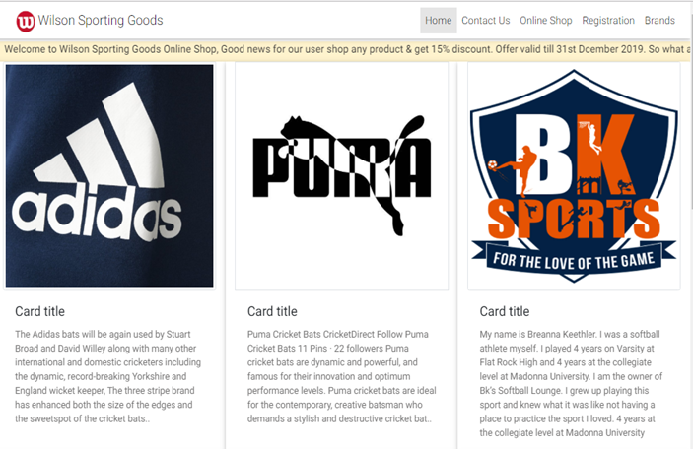
BRANDS

Slide 14
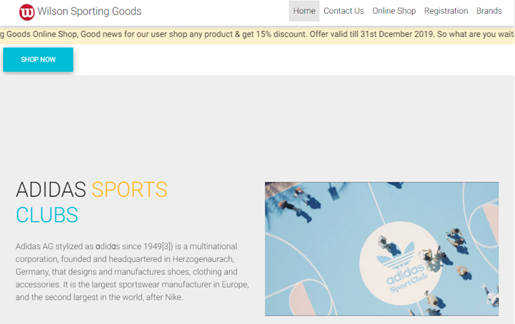
BRANDS

Slide 15
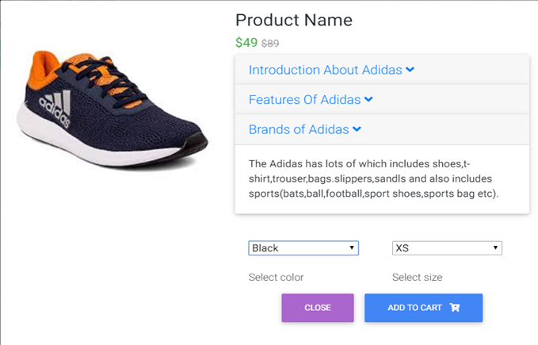
BRANDS

Slide 16


